Slide 1
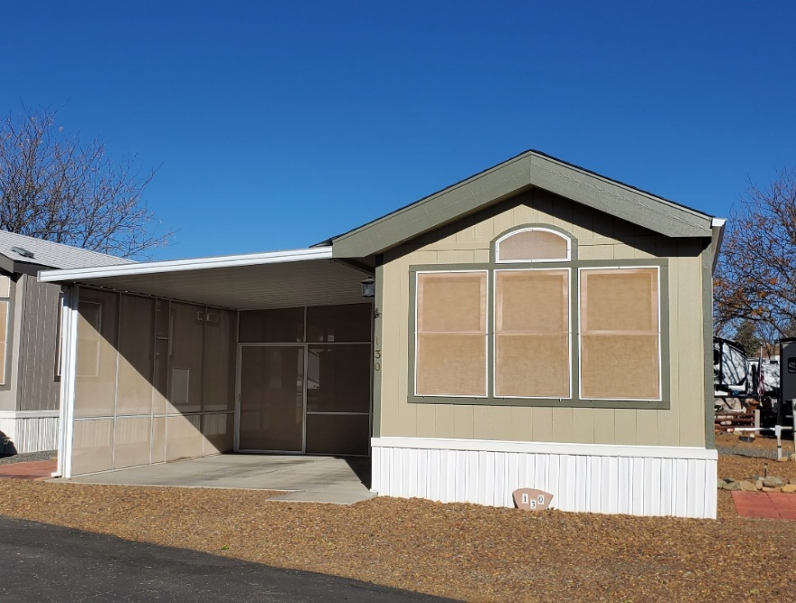
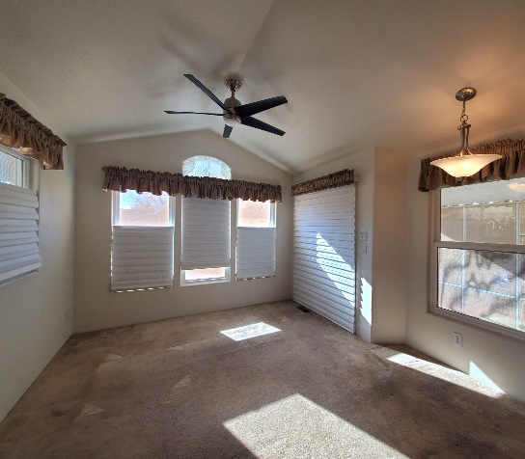
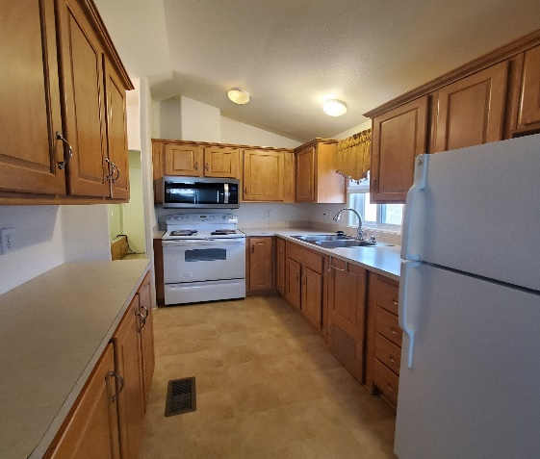
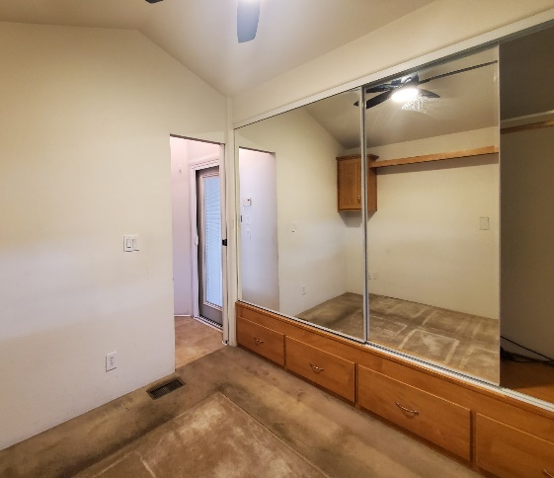
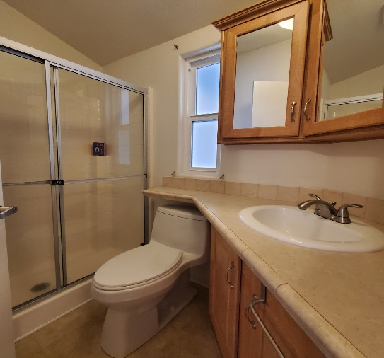
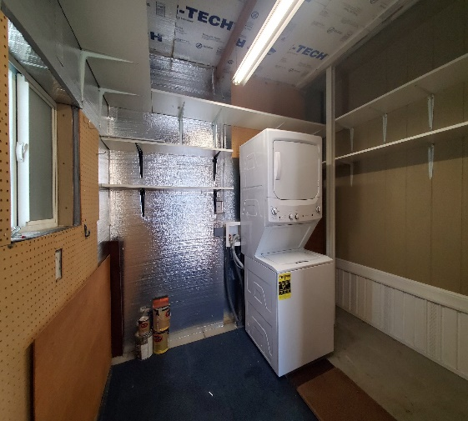
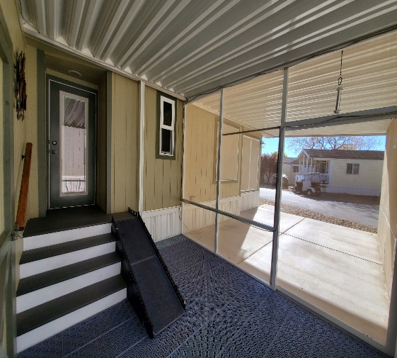
Orchard Ranch Site # 130 2009 Cavco
11250 E. State Hwy. 69, Dewey Az. 86327
928-772-9942
Park Model Home
Priced at $92,500
1 bedroom/1 bath
Approx. 400 sq. ft.
This Cozy Getaway Awaits.
An ample side & backyard, Screened in patio & carport. New doubled pane windows, custom blinds t/o.
Ceiling Fans w/remotes, in Living room and Bedroom.
Kitchen S/S sink, with w/plenty of cabinets space
and white Electric Appliances. Lg. capacity stacked W /D.
Newer A/C & Heater pump.
New taller toilet in Bathroom with walk in shower.
Sun shades on all windows.
New Roof 2 years ago. Leveled in 2023
This home merits a visit.
Additional Information:
All of the amenities in the community are yours to enjoy, including: Pool, Spa, Billiards, Horseshoes, Shuffleboard, TV & Library Room, Exercise Room, Recreation Hall and Planned Group Activities.
Most Homes Include: Awning, Concrete, Skirting, AC/Heat and Shed
Annual Personal Property Tax on the home is paid by the homeowner, through the Yavapai County Treasurer’s Office
NO HOA FEES!!!

